Slide 1
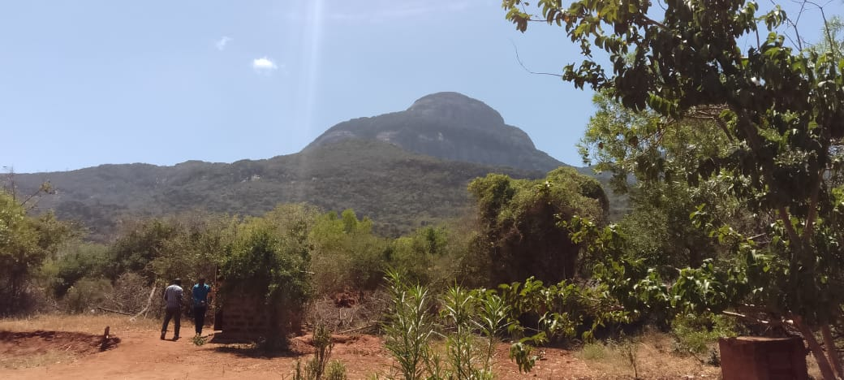
TARCC Presentation
January 2023 to MARCH 2025

Slide 2
Introduction to TARCC
Taita Resource Centre Community Based Organization (CBO) is apolitical and a non-partisan community based and driven organization registered to pursue protection, promotion and preservation of rights and the wellbeing of communities in the Coastal region of Kenya. The organization mainly seeks to address needs and challenges affecting grassroots indigenous and local communities and cumulatively works to better the welfare of these communities and the natural environment. Its delivery strategies include: advocacy; cooperation, sensitization; education and training; capacity building; facilitating problem-solving; and, empowerment. Key in its intervention efforts, is multi-level collaborations and partnerships that continuous engage main stakeholders and actors of interests in its works. Under this proposed project, it has partnered with like-minded leaders of communities and community organizations across other coastal Counties to advance the land rights agenda in the region.

Slide 3
Intro continued’
Under the CLAN! LTF land project, TARCC is partnering with a total of 12 communities in the Coastal region; ranches, forest and settled communities across the Coastal region of Kenya. These are Sanye and Awer in Lamu County, Milalulu in Tana River County, Gede and Mtsara Wa Tsatsu in Kilifi county, Mwereni and Gumbato in Kwale county, Miasenyi, Mramba, Mgeno, Kasigau and Chawia/Mkuki (Chawuse) in Taita Taveta county.

Slide 4
Activities under the CLAN! TF project
FREE PRIOR AND INFORMED CONSENT (FPIC); activities took place in the all the 12 communities of the coastal region of Kenya. These formed the basis of all the activities that TARC has undertaken since the inception of the project in January 2023
COMMUNITY CONSULTATION MEETINGS; In addition to FPIC meetings consultation meetings bringing together community members, leaders, opinion shapers, Ministry of lands officials, county government officials and national government administrative officials were held. These were important in laying strategies and approaches to the myriad of issues to be tackled at community level.

Slide 5
Activities Cont’d
Making of community constitutions/registers; These were successfully done in 6 communities of the 12 that TARCC is working with. Prior to the drafts of the said constitutions being adopted by the community members, the contents of the said were exhaustively deliberated during the consultative meetings. After the passage of the constitutions, the register of community members were then prepared as per the Community Land Act regulations. Copies of the same are available at TARCC’s offices.
CLMC ELECTIONS; These were conducted successfully after the constitution and registers were made and adopted; the exercises were conducted by the respective Community Land registrars assisted by officials from county governments and national government administrative officers. Process ongoing in other communities (NB; this is one of the most challenging exercise undertaken by TARCC; Mramba case already in court)

Slide 6
Activities cont’d
Land Use Plan making; This has only happened on one community; Chawia Mkuki (Chawuse) as it is a requirement of the law. Firstly, the Chawuse community expressed the desire to reclaim their ancestral land after the expiry of the 45 year lease held by one late Brigadier Oliver Mkungusi. The community filed a petition through Taita Taveta County Assembly which subsequently adopted it. The County government then took it up via an application to the National Land Commission to enable conversion of the 6,000 acre piece of land. After receipt of the application, the NLC. A Notice Of Intention was published by the CG of Taita Taveta last February i.e. Feb 28th 2023 thereby kickstarting the process which involves both surveying and planning. The community sought the expertise of a Geophic Company Nrb to do the work. The process began by TARCC undertaking 5 large community meetings in Chawia ward attended by the surveyors, planners, elders, NGAO’s, CG Lands officials, CLMC members, elected leaders among others in late November 2023. A topographical survey followed in mid January 2024 and the community is awaiting the finalization of the report/plan before it is submitted to CG Lands dept for approval and later to National Land Commission for issuance of Letter Of Allotment. The NLC Commissioners are scheduled to make a site visit later this May 2025 before the Title is issued.

Slide 7
Activities Cont’d
RADIO TALK SHOWS; though not in the prepared work plans, the 2 talk shows conducted came in handy in reaching the communities who weren’t able to attend the FPIC not the consultative meetings. View and questions raised during the deliberations went a long way in making the communities understand the community land registration process better and in particular the role undertaken by CLAN! and TF in enabling this to happen.
CRICL RESPONSIBLE INVESTMENTS: 2 activities were done zeroing in carbon credit and conservation in Kasigau community in Voi sub county.
Successful training of paralegals who are domiciled in the 12 communities; all 24 are now working and reporting monthly to TARCC
Petition; A petition was tabled in Parliament by the Awer community on the degazettement of the Boni Lungi forest by Lamu MP Cpt Ruweida Obo in mid December. The process still ongoing in parliament
HLI hearings were conducted successfully in March 2025 in Kwale County whereby Gumbato/ Denyenye community presented their claims before the NLC; Awer and Sanye are yet to do so before the NLC.TARCC took part in community mobilization and preparation of documents.

Slide 8
Stage of Progress on Registration
Community | Stage of progress | Population of community | Size of land (Ha)
Kasigau | Constitution, register, CLMC in place, adjudication to be done after boundary agreed upon. County govt and NLC have agreed to embark on process of conversion of the rest of the land which is currently public into community land. | 8,000 | 11,735
Chawia Mkuki | Constitution, register, CLMC in place, Developed Land Use Plan for approval by GG Taita taveta, conversion process complete, awaiting issuance of Title Deed later this month after site visit by NLC commissioners in May 2025 before a community Titte deed is issued. | 7,500 | 2,428
Awer | Stage 1;Petition in National Assembly of Kenya since last year, awaiting hearing process. The community has also embarked on converting Panda Nguo into Community land as the Boni Lungi matter is being canvassed in parliament. | 7,000 | 80,039
Mramba | Stage 3:Constitution, register, Gazetted for adjudication, ADR needed after court stopped CLMC election after an application was made in Voi High court. The Court has ordered an ADR to be completed by May 26th; all parties to take part. TARCC is facilitating the ADR process and will update CLAN on outcome/progress | 13,800 | 8,093
Gumbato | Stage 1:community has submitted CLA1 and 3; presented HLI case to NLC in March 2025 . Kwale CG has opted to ask for funds from NG to buy off the land and settle the community in the land as Community land. | 6,000 | 1,000
Mgeno | Constitution, register, CLMC in place, Gazetted, awaiting surveying/adjudication once monies are released. The exercise to begin on the 13th May 2025. | 22,000 | 4,500
Gede | Constitution, register in place , CLMC in place, Gazetted, awaiting surveying/adjudication once monies are released. The exercise is also expected to kick off in May 2025 taking 21 days. | 6,000 | 1,619
Milalulu | Constitution, register, Gazetted, awaiting surveying/adjudication; security concerns being addressed; the Tana river CG is expected with the support of TARCC to kicks tart the process of conversion of the said land from public to community land. | 10,000 | 58,276
Mtsara | Constitution, register, CLMC in place, Gazetted, awaiting surveying/adjudication. The community and Kilifi county government are ready for the survey exercise once the funds are available. | 5,000 | 1,000
Miasenyi | Stage 1; community has finally submitted CLA1 and 3 to the Community land registrar. Meanwhile the Taita Taveta CG has also began the process of conversion of the land from public (livestock fattening center) to community land.
Mwereni | Constitution, register, CLMC in place, to undergo surveying/adjudication once ownership issues are resolved; there is serious interference from politicians) | 40,000 | 43,300

Slide 9
Achievements of the project since january 2023 TO DATE
Community | Type of recognition (by Government) | Period of recognition | Size of land (Ha) | Population of community
Mramba | Kenya Gazette notice No 6093 of 2023; | May 2023 | 8,093 | 4,000
Mgeno | Kenya Gazette notice No: 6093 of 2023;awaiting survey, preparations done | May 2023 | 4,500 | 22,000
Chawia/Mkuki (Chawuse) | Registered as a community by the Ministry of Lands . Land Use Plan done, community awaiting Title Deed | 5th October 2023 | 2,428 | 7,500
Kasigau | Registered as a community by the Ministry of lands | 26th July 2023 | 11,735 | 8,000
Milalulu | Kenya gazette notice of 6094 of 2023 | June 2023 | 58,276 | 10,000
Gede | Kenya gazette notice of 6094 of 2023;awaiting survey preparations done | June 2023 | 1,619 | 6,000
Mtsara Sanye | Kenya gazette notice of 6094 of 2023;awaiting survey Petition being prepared for submission to NA; CLA1/3 to follow | June 2023 | 1,000 | 5,000

Slide 10
Challenges and Opportunities
Lack of adequate Community preparedness; this was the most notable challenge that TARC experienced in the first 5 months of project implementation. Some communities had sudden change of leadership while others were sceptical of the intentions and outcomes of the project; primarily owing to past experiences with other actors; these were addressed during the FPIC meetings.
Government bureaucracy and red tapes; the land issue has for been fodder for corrupt government officials to make profits; some viewed this project as an impediment to continue feeding from the land gravy train; hence gave the TARCC staff a cold shoulder in the initial stages of implementation; but gradually this was allayed after successful and robust FPIC meetings were held and the said officials witnessed the enthusiasm and faith the communities had in the CLAN! LTF land project.
Vested interests amongst top government leaders and powerful politicians
Entrenched traditions within communities e.g. non involvement of women and youth on matters concerning land; this was common across all the communities

Slide 11
Opportunities:
Capacity building by the CLAN! secretariat on FPIC, CLA Act, Alternative Dispute resolution and even interaction leading to enhanced capacity in TARCC in spearheading the registration process. The experiences and information the duo shared during the December 2022 and January 2024 capacity building for the IPs served as an opportunity in building immensely the resolve TARC has/Had in ensuring that the communities targeted in the project are successful in registering their communal lands. The secretariat staff Finance, Coordinator and TF Financial advisor have been gracious enough to visit our Mwatate offices for induction and guidance on governance.
TARCC also had the opportunity of taking part in the Africa Learning Exchange (convened by TF, ILC and CLAN!) conference held in Naivasha Kenya in early October 2023; this platform brought different land related campaigners from all over the world thus offering a perfect opportunity for learning and sharing experiences from within and other areas of the world. TARC was also bale to create linkages with other agencies present thus offering a brighter future to this process of securing land for IP and LCs. In addition to this the CLAN secretariat also coordinated other meetings within Kenya; both physical and online which have gone a long way in building synergy and skills in this important journey.
Visitation by Clan secretariat; SC and Tenure Facility to TARCC’S offices in Mwatate, Taita Taveta County led by Cath Traylor in January 2025 have served to boost the capacities of TARCC both internally and in the manner in conducts its community work.

Slide 12
Opportunities
Shared platforms with national elected and appointed leaders; the more than 17 meetings held with Governors, heads of Land departments in 5 counties of Kwale, Taita Taveta , kilifi, Tana River and Lamu, Principal secretary of Mining, MP’s of Mwatate, Voi, Msambweni, Lungalunga, Ganze and Kilifi North constituencies also served to present rare opportunities to mitigate on any issues affecting the targeted community lands in the coastal region of Kenya; this has served to fast track the process of conversion of the lands into community lands hence the gazettements done by the CS Lands and Physical Planning paving way for communities to realise their prime objective of ownership.

Slide 13
Lessons Learned
Every community is unique and all approaches have to conform with the needs and wants of the said communities. This was challenging as the project has a clearly outlined Work Plan which was undesirable with some communities; so a middle ground had to be reached to enable the communities to benefit and the CLAN! LTF land project also be able to meet its objectives. In planning for the future activities there’s great to allocate more time as each community’s situation is unique to itself

Slide 14

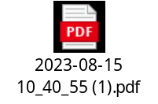
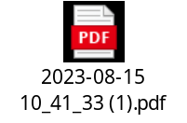

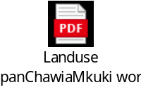
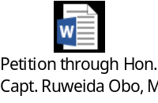

Kenya gazette Documents and photos

Slide 15
Expenditure ; january to dec 2024
|Refer to excel document

Slide 16
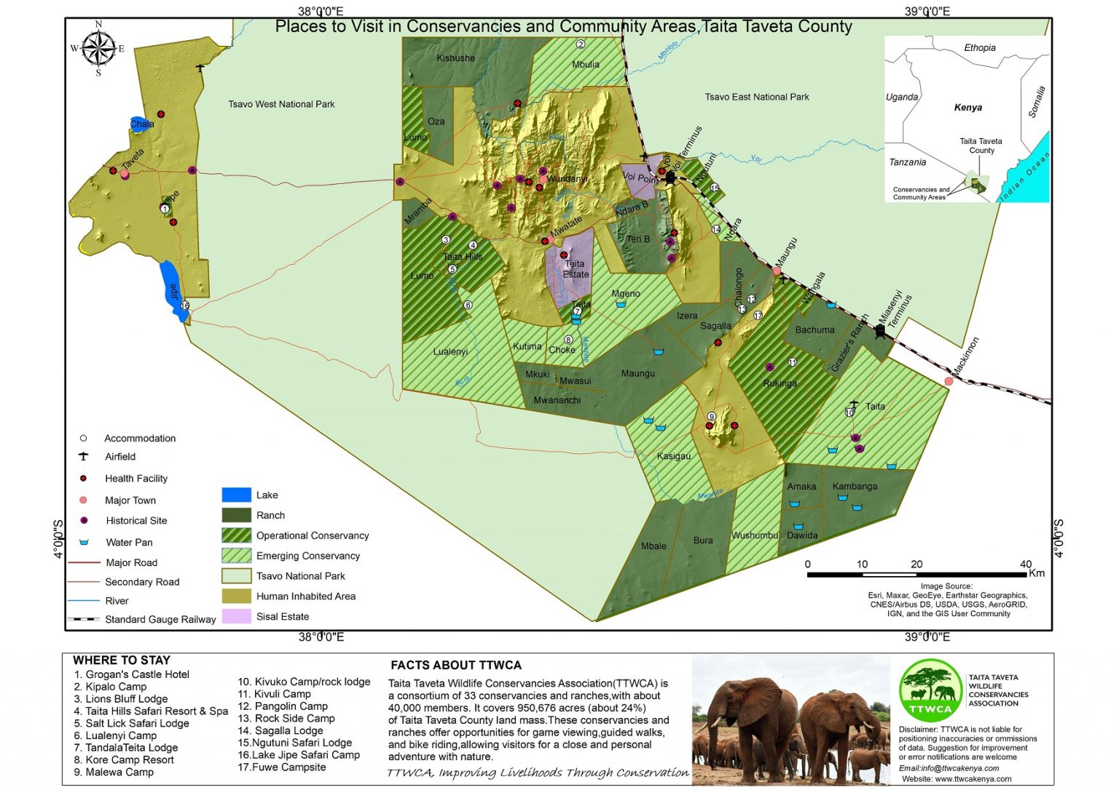
Maps; targetd community lands in taita taveta

Slide 17
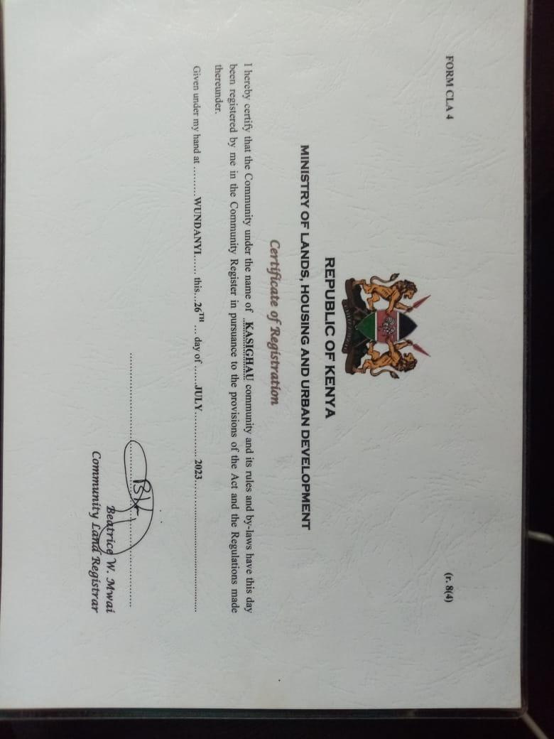
Certificate of registration; kasighau

Slide 18
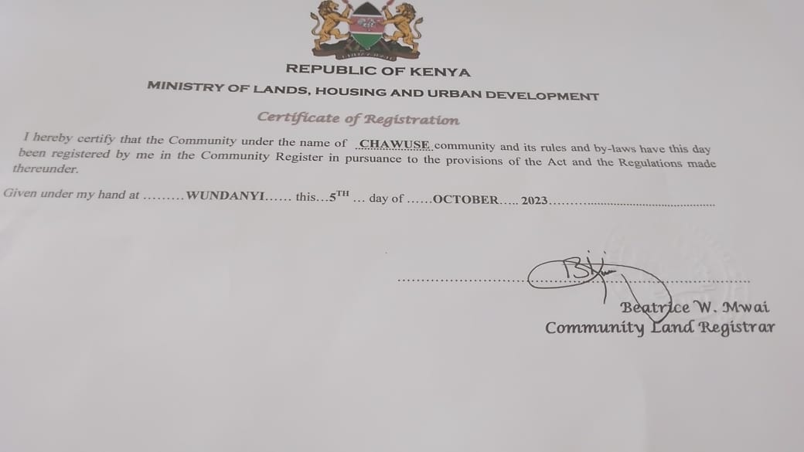
Certificate of registration (chawuse; Chawia Mkuki)

Slide 19
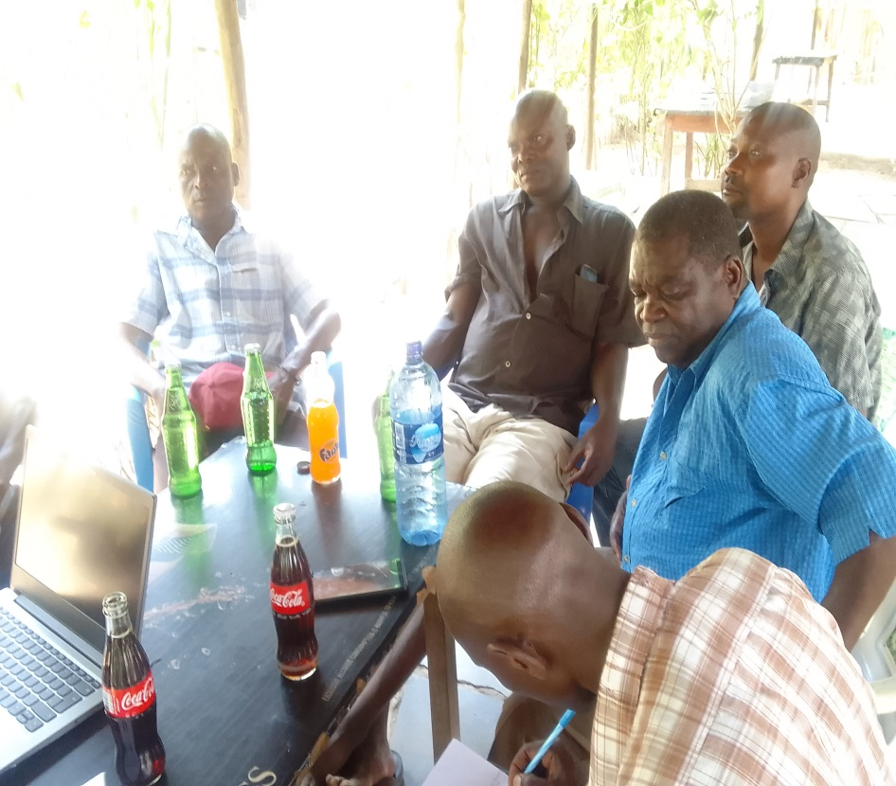
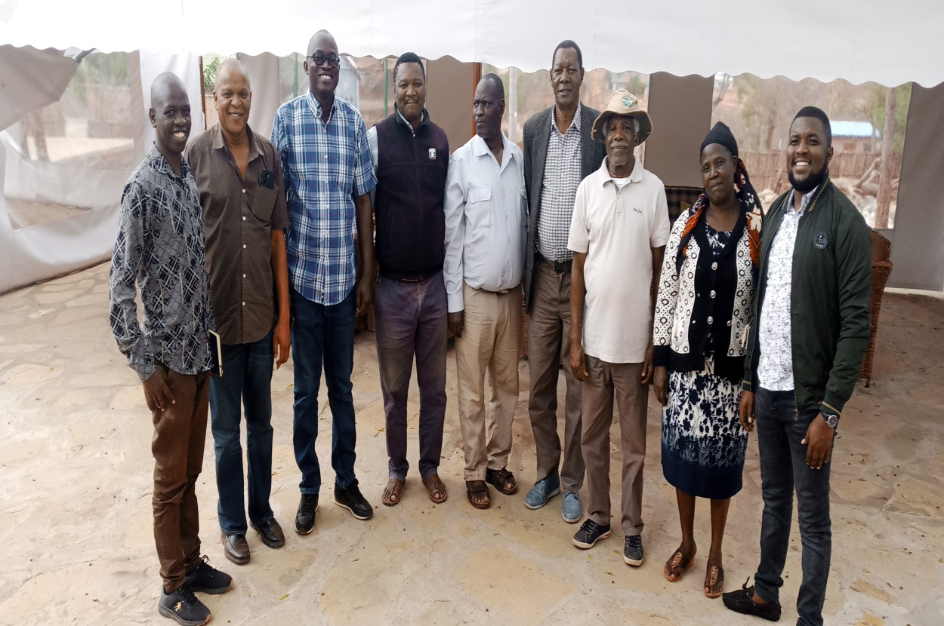
photos

Slide 20
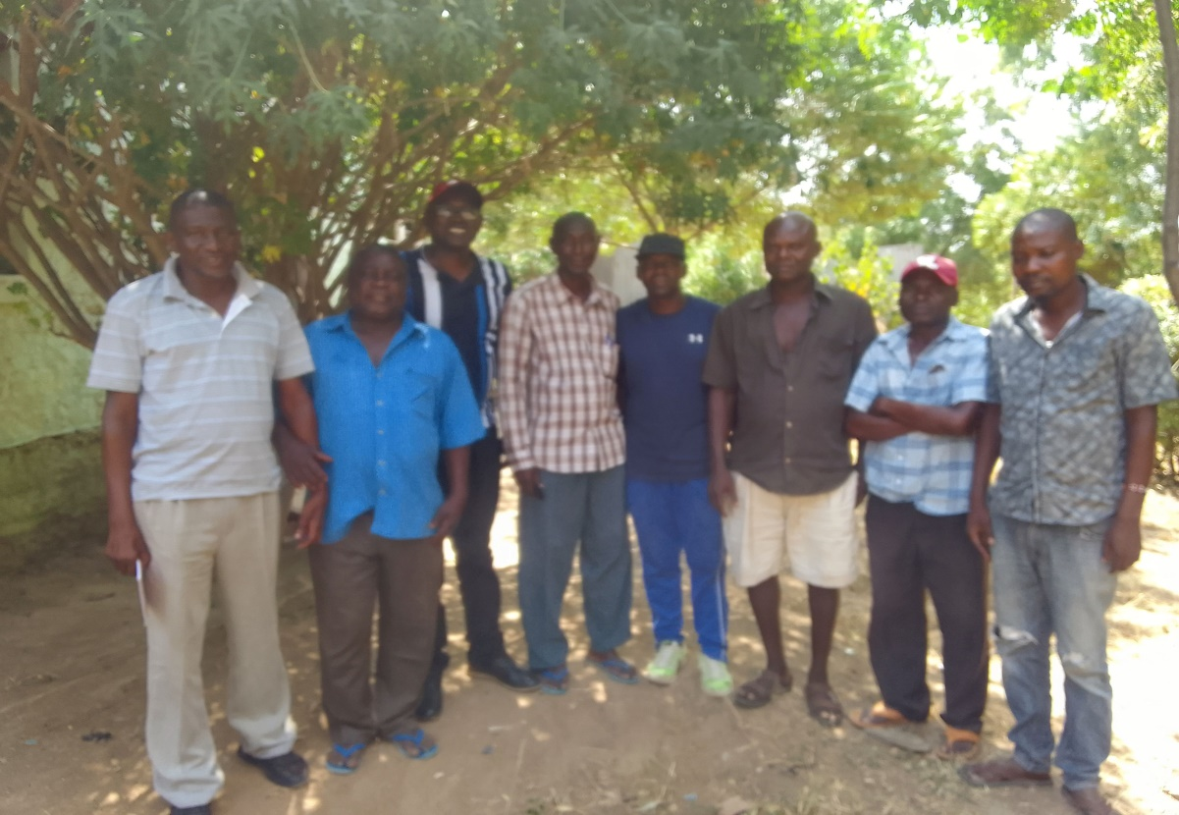
photos

Slide 21
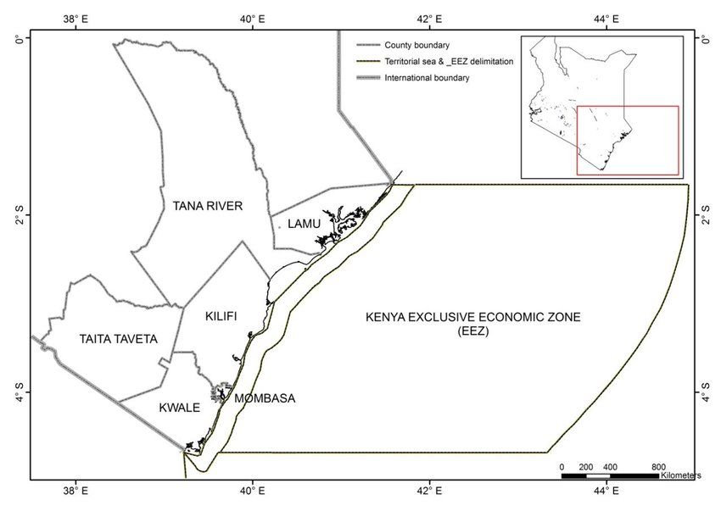
MAP OF TARC’S PROJECT AREA IN COASTAL REGION OF KENYA

Slide 22
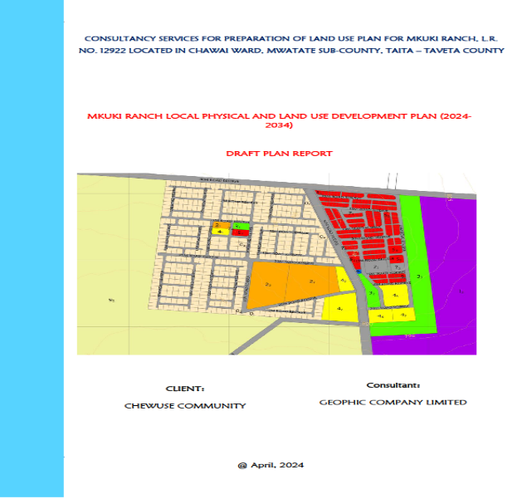
Chawuse lup report

Slide 23
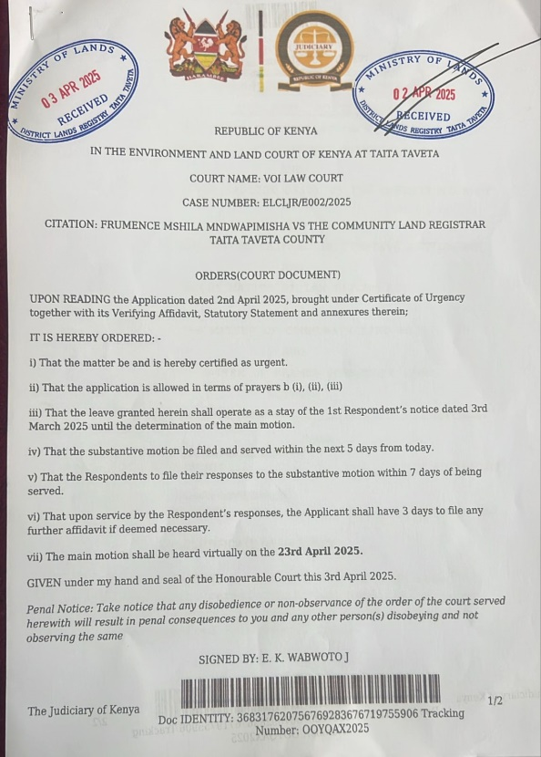
MRAMBA COURT ORDER

